Slide 1
“Athena”: A Beacon of AI-Enabled Healthcare Transformation- Resource Allocation and Policy Customization
Presented at the eHealth4everyone: AI4Healthcare Hackathon
Team B
September, 2023

Slide 2

Outline
Introduction
Problem Statement
Methods & Description- “Athena”
Market size & Opportunities
Challenges and Recommendations
Call to action
Team profile
Conclusion
References

Slide 3
Introduction
SDG3: Ensure healthy lives and promote well-being for all at all ages.
Poor healthcare resource allocation and financing key challenges in Africa.
Poorly informed policy decisions, a major cause of persistently depressed metrics.
About 40% of Nigerians live in poverty, social conditions that create ill health.
Low life-expectancy in Nigeria (54 years); High U-5 mortality than other countries!
Improving health equity and tailored policies, vital in achieving SDG3.

Slide 4

Introduction
Health informatics and Digital health are proposed as tools to achieve fairness in healthcare resource allocation.
Algorithmic fairness highlights specific opportunities where machine learning, public and population health may synergize to achieve health equity.
AI’s role is functional in contributing novel knowledge to public health.

Slide 5
Problem Statement
Significant challenge in efficiently allocating resources and customizing healthcare policies, especially in low-resource settings.
Healthcare administrators and policy makers lack tools and systems needed to make informed decisions regarding resource allocation and policy adjustments.
Consequent, regional health disparities and poor healthcare indices.

Slide 6
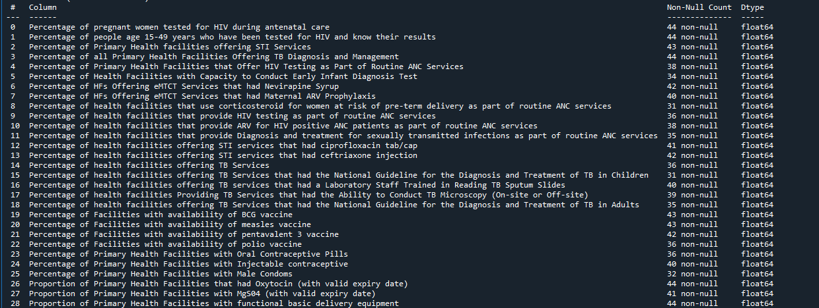
Methods & Description- “Athena”

Slide 7
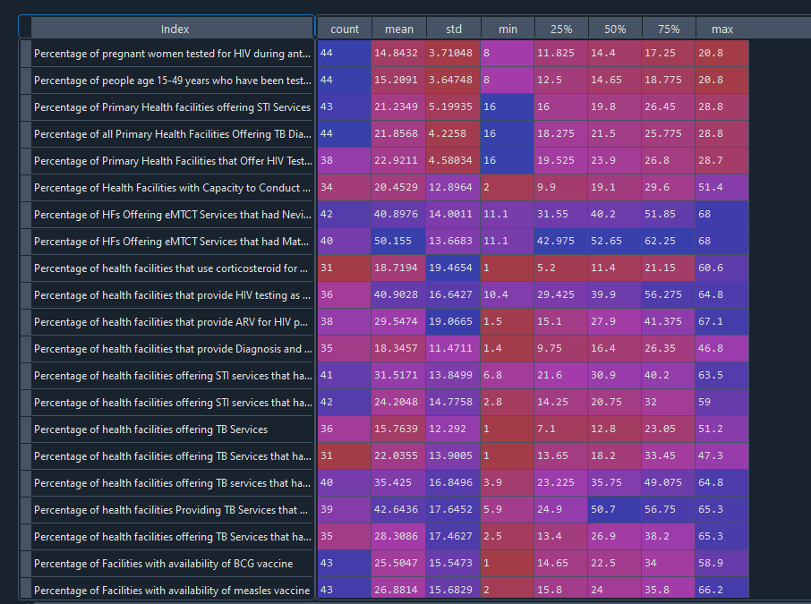
Methods & Description- “Athena”

Slide 8

Methods & Description- “Athena”
Nulls filled with mean of group.
Correlational analysis revealed trends
Also, % of facilities offering HIV testing as part of routine ANC was negatively correlated with % facilities offering TB services that had National guidelines for diag. & treat. of TB in children.

Slide 9

Methods & Description- “Athena”
Clustering algo- PCA + Kmeans. Similar resources, policies and interventions are expected to work for groups in the same clusters
Health index categorization algo- DL AutoEncoder + Quantile stats. Prioritization in resource allocation and policy formulation based on health index
Summary & recommendation chat LM- meta-llama/Llama-2-70b-chat-hf. Inferences are non-technical and allow for data-driven, tailor-made health policies

Slide 10
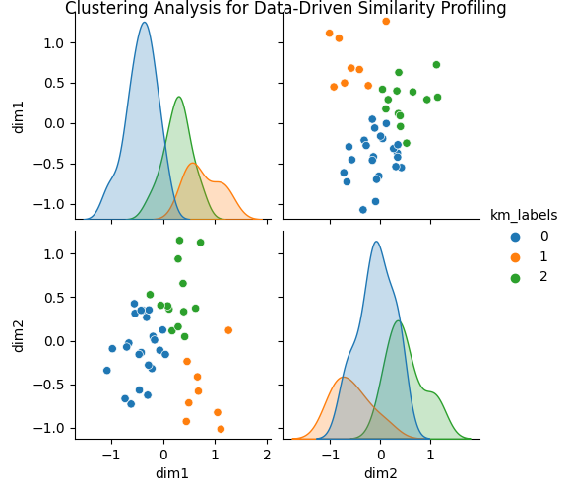
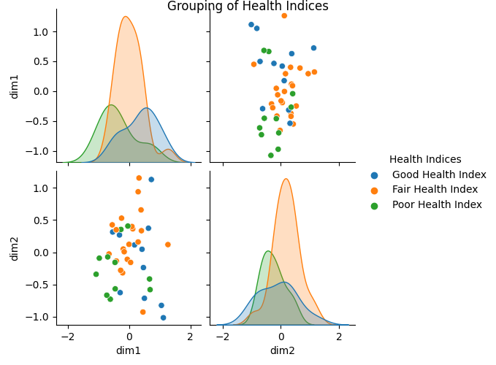
Methods & Description- “Athena”

Slide 11
Methods & Description- “Athena”
AI Generated Summary:
The healthcare system in Bayelsa, Nigeria, faces several challenges in providing quality care to its population. Some areas of concern include:
Low percentage of health facilities offering essential newborn care services, such as early infant diagnosis tests and maternal ARV prophylaxis.
Limited availability of critical medicines and supplies, including corticosteroids for pre-term deliveries, HIV testing kits, and ARV drugs for HIV-positive patients, ………………

Slide 12
Methods & Description- “Athena”
AI-Generated Recommendations
To address the gaps in healthcare service delivery in Bayelsa, the following recommendations are proposed:
1. Strengthen health systems management: Improve leadership and governance structures to enhance coordination and accountability among healthcare providers. Develop robust monitoring and evaluation frameworks to track progress towards healthcare goals.
2. Scale up training and capacity building: Provide regular training and capacity-building programs for healthcare workers on essential newborn care, HIV testing, and TB diagnosis and treatment. Strengthen mentorship programs to support health workers in rural areas………..
By implementing these recommendations, Bayelsa can significantly improve its healthcare system, move closer to achieving the SDG3 targets, and ultimately ensure better health outcomes for its population.

Slide 13
Market size & Opportunities
In 2013, Healthcare AI companies raised USD 4.3 billion globally across more than 500 equity deals.
Global market for healthcare predictive analytics valued at USD 1.48 billion in 2015.
Expected to grow at a rate of 29.3% (compound annual growth rate) by 2025.
Government bodies/initiatives, Policymakers, Funding agencies, Healthcare bodies, and research organizations.
Partnerships and Collaborations- NGOs, Public-Private etc.
Improved healthcare delivery, Health Equity, data-driven policies, better health metrics, value-based care, research, and telemedicine.

Slide 14
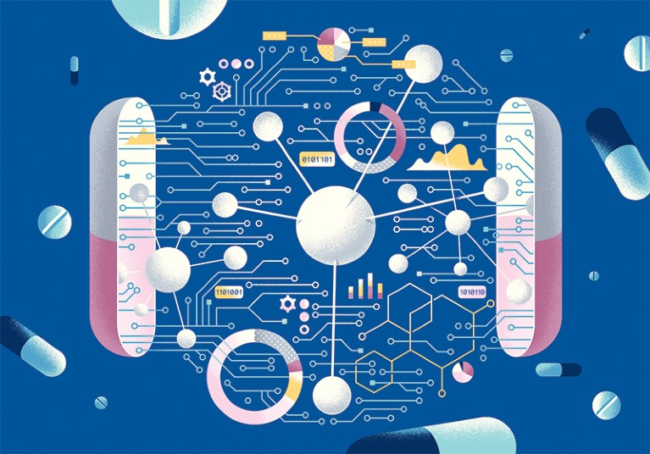
Challenges
Limited data accessibility
Poor data quality from MSDAT - missing values
Restricted computational power
Difficulty validating unsupervised models
Culture and Language agnostic
User Adoption and Training

Slide 15
Recommendations
Collaborative effort between local heath care providers and regional organizations to establish quality, large databases.
Large-scale practical, public health research to assess performance and implementation of models.
Effort on legal and ethical adherence to resource Health AI.
Comprehensive support and training of concerned health bodies on Health AI algorithms.
Provision of appropriate hardware for massive scalability.
Community engagement and involvement in healthcare policy discussions.

Slide 16
Call to action
Are you a healthcare leader, innovator, or policymaker?
Are you passionate about improving healthcare access and outcomes in underserved communities?
Do you believe in the power of AI to transform healthcare for the better?
It’s Time to Act!
Collaborate-Global Impact-Innovation-Improving Lives-Research & Development-AI
Together, we can “Athena” the beacon of hope for healthcare transformation in low-resource settings

Slide 17

Team Profile
Members
Taofeeq Togunwa (Data Science/AI)
Sodiq Jinad (Data Science/AI)
Mentors
Joseph Ologunja (AI Mentor)
Aniekan Eric (Public Health Mentor)

Slide 18
Conclusion
In the journey to address the complex challenges of healthcare, particularly in low-resource settings, “Athena”- with a focus on AI-enabled healthcare prioritization, resource allocation, and policy customization; is posed to revolutionize healthcare delivery worldwide.
“Of all the forms of inequality, injustice in health is the most shocking and inhumane.” — Martin Luther King Jr.

Slide 19
References
Brewer LC, Fortuna KL, Jones C, Walker R, Hayes SN, Patten CA, Cooper LA Back to the Future: Achieving Health Equity Through Health Informatics and Digital Health JMIR Mhealth Uhealth 2020;8(1):e14512 doi: 10.2196/14512
Denis Horgan, Mario Romao, Servaas A. Morré, Dipak Kalra; Artificial Intelligence: Power for Civilisation – and for Better Healthcare. Public Health Genomics 5 February 2020; 22 (5-6): 145–161. https://doi.org/10.1159/000504785
Love-Koh, J., Griffin, S., Kataika, E. et al. Methods to promote equity in health resource allocation in low- and middle-income countries: an overview. Global Health 16, 6 (2020). https://doi.org/10.1186/s12992-019-0537-z
Mhasawade, V., Zhao, Y. & Chunara, R. Machine learning and algorithmic fairness in public and population health. Nat Mach Intell 3, 659–666 (2021). https://doi.org/10.1038/s42256-021-00373-4
Obinna O Oleribe, Jenny Momoh, Benjamin SC Uzochukwu, Francisco Mbofana, Akin Adebiyi, Thomas Barbera, Roger Williams & Simon D Taylor-Robinson (2019) Identifying Key Challenges Facing Healthcare Systems In Africa And Potential Solutions, International Journal of General Medicine, 12:, 395-403, DOI: 10.2147/IJGM.S223882

Slide 20
References Cont’d
Shahid N, Rappon T, Berta W (2019) Applications of artificial neural networks in health care organizational decision-making: A scoping review. PLOS ONE 14(2): e0212356. https://doi.org/10.1371/journal.pone.0212356
The Lancet Nigeria Commission: investing in health and the future of the nation. Abubakar, Ibrahim et al. ,The Lancet, Volume 399, Issue 10330, 1155 - 1200

